Slide 1

18CSS202J - COMPUTER COMMUNICATIONS
Semester 4 – Academic Year 2021-2022 (Even)

Slide 2
Course Objective:
The purpose of learning this course is to
Understand the basic services and concepts related to Internetwork
Understand the layered network architecture
Acquire knowledge in IP addressing
Exploring the services and techniques in physical layer
Understand the functions of Data Link layer
Implement and analyze the different Routing Protocols
Course Outcomes (CO):
At the end of this course, learners will be able to
Apply the knowledge of communication
Identify and design the network topologies
Design the network using addressing schemes
Identify and correct the errors in transmission
Identify the guided and unguided transmission media
Implement the various Routing Protocols

Slide 3

UNIT –I Contents
Evolution of Computer Networks
Network Categories
Data Transmission Modes
Network Topologies
Circuit Switching and Packet Switching
Protocols and Standards
OSI Layers and its functions
TCP/IP Protocol Suite
Link Layer Protocols
Network Layer Protocols
Transport Layer Protocols
Serial and Parallel Transmissions
Addressing

Slide 4
Session 1
Evolution of Computer Networks
Network Categories
Data Transmission Modes
Network Topologies

Slide 5
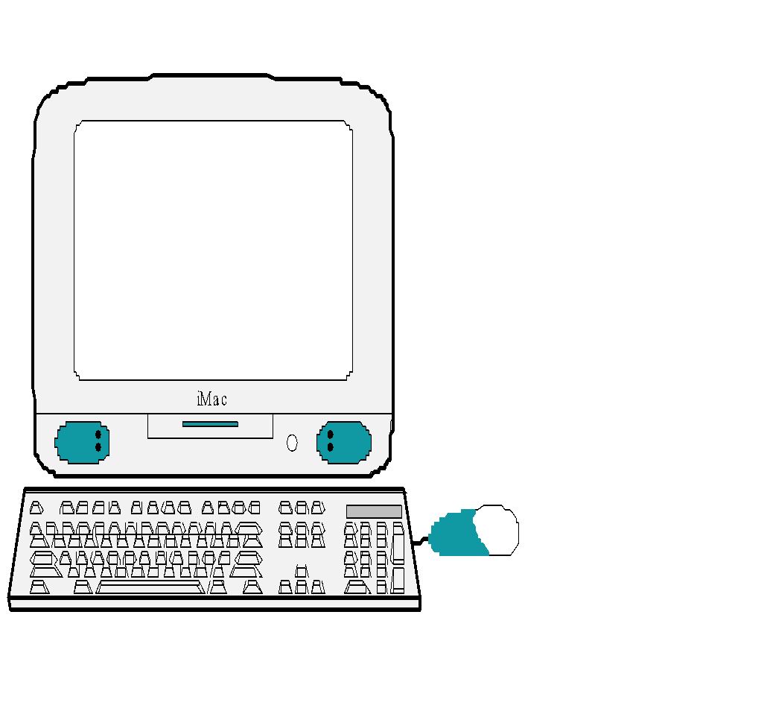
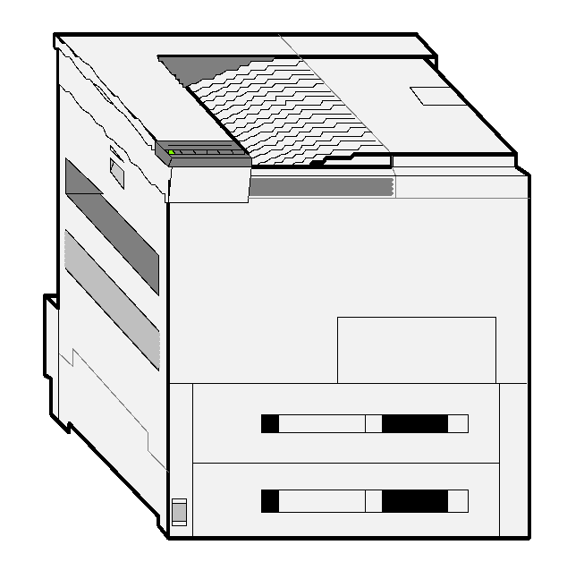
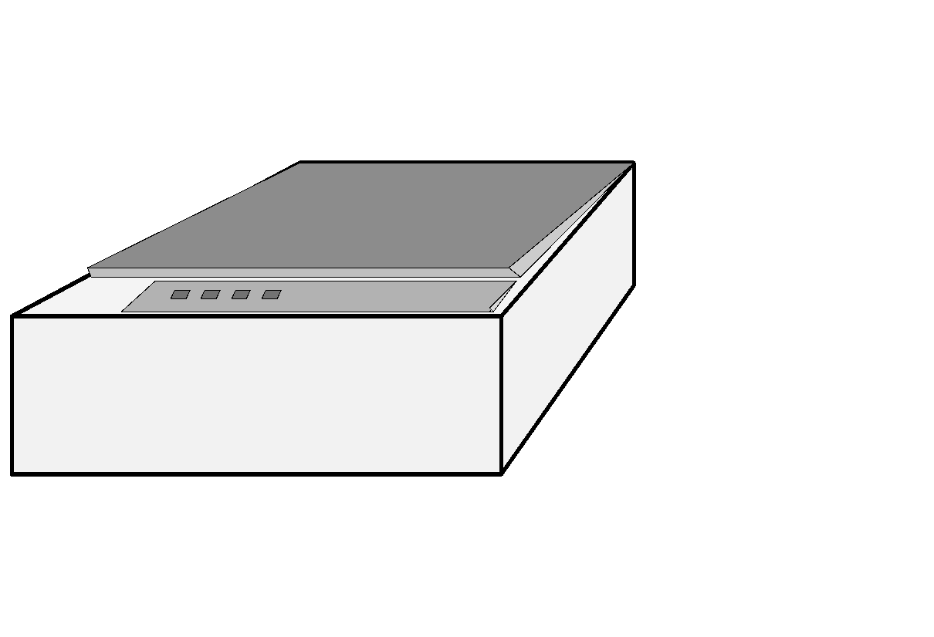
Networks
Network: a set of devices connected by media links
Laptop
Workstation
Media Links
Server
Printer
Scanner

Slide 6
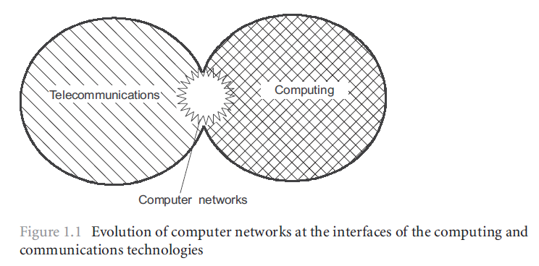
Evolution of Computer Networks
Computer Networks?
A group of interconnected computers
The evolution of two important scientific and technical branches of modern civilization
Computing and
Telecommunications technologies

Slide 7
Evolution of Computer Networks
Communication Network?
A network of links and nodes arranged messages may be passed from one part of the network to another
What are nodes and links?
People and roads
Telephones and switches
Computers and routers
What is a message?
Information

Slide 8
Evolution of Computer Networks
Networks are Old
2400 BC: courier networks in Egypt
550 BC: postal service invented in Persia
Problems
Speed
Reliability
Security
1837: Telegraph invented by Samuel Morse
Distance: 10 miles
Speed: 10 words per minute
In use until 1985!

Slide 9
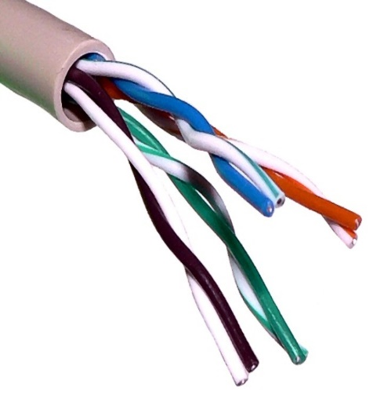

Evolution of Computer Networks
1881: Twisted pair for local loops
1885: AT&T formed
1892: Automatic telephone switches
1903: 3 million telephones in the US
1915: First transcontinental cable
1927: First transatlantic cable
1937: first round-the-world call
1946: National numbering plan
Telephone network is the dominating
communication network
Used circuit switching

Slide 10
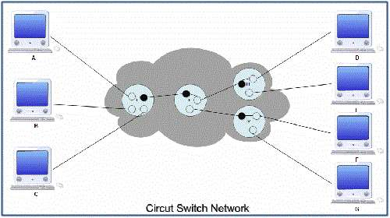
Evolution of Computer Networks

Slide 11
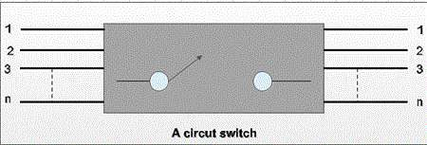
Evolution of Computer Networks
Circuit switching
Telephone networks are circuit switched
Each call reserves resources end-to-end
Provides excellent quality of service
Problems
Resource intense (what if the circuit is idle?)
Complex network components
(per circuit state, security)

Slide 12
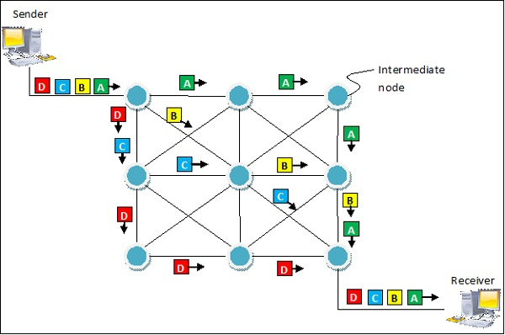
Evolution of Computer Networks
Packet Switching

Slide 13
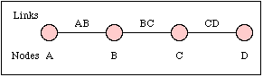
Evolution of Computer Networks
Packet switching
No connection state, network is store-and-forward
Minimal network assumptions
Statistical multiplexing gives high overall utilization
Problems
Resource intense (what if the circuit is idle?)
Complex network components
(per circuit state, security)

Slide 14
Evolution of Computer Networks
From the ARPANET to the Internet
The Advanced Research Projects Agency Network (ARPANET)
It is one of the world's first packet switching
networks
The first network to implement TCP/IP, and was the main progenitor of what was to become the global Internet. (later DARPA)

Slide 15
Evolution of Computer Networks
Internet
The Internet is a global system of interconnected computer networks that use the standard Internet protocol suite (TCP/IP) to link several billion devices worldwide
The packet switching of the ARPANET, together with TCP/IP, would form the backbone of how the Internet works
1972:
ARPAnet is nowconsistent of 15 nodes
The first host-to-host protocol
NCP (Network Control Protocol) enablesapplications to be written
First e-mail program

Slide 16
Evolution of Computer Networks
ALOHAnet
Enabling communication over microwaves between the Hawaiian Islands.
NSFNET
Connection to supercomputing centers
56kbps backbone, later 1,5Mbps and serving as the linkingbackbonebetween regional networks
CSNET
Linking researchers without access to the ARPAnet
BITNET
University e-mail and file sharing
TCP/IP replacing NCP as the standard hostprotocol for ARPAnet

Slide 17
Evolution of Computer Networks
Brief History of the Internet
1961: Kleinrock @ MIT: packet-switched network
1962: Licklider’s vision of Galactic Network
1965: Roberts connects computers over phone line
1967: Roberts publishes vision of ARPANET
1969: BBN installs first
InterfaceMsgProcessor at UCLA
1970: Network Control Program (NCP)
1972: Public demonstration of ARPANET
1972: Kahn @ DARPA advocates
Open Architecture
1972: Vint Cerf @ Stanford writes TCP

Slide 18
Evolution of Computer Networks
1958: First use of a modem
Machine to machine communication
Analog vs. digital signals
Many different computer networks
Local vs. global
LAN, WAN
Public Vs Private
Internet2, SRMNet
General purpose vs. special purpose
E.g. credit cards, banks, defense

Slide 19
Evolution of Computer Networks
Early 1990s: WWW
Hypertext
HTTP: Tim Berners-Lee develops WWW an Internet based hypermedia initiative, and specifies URLs, HTTP and HTML which became basis for today’s WWW
1994: Mosaic (Univ. of Illinois), later Netscape the major browsers until late 1990’s
Commercialization of the WWW, with introduction of HTTPS e-commerce is realized
Late 1990’s:
50 million computers on Internet
100 million+ users
backbone links running at 1 Gbps

Slide 20
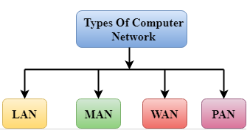
Network Categories

Slide 21
Characteristics of LAN
LAN – Local Area Network
MAN – Metropolitan Area Network
WAN – Wide Area Network
PAN – Personal Area Network

Slide 22
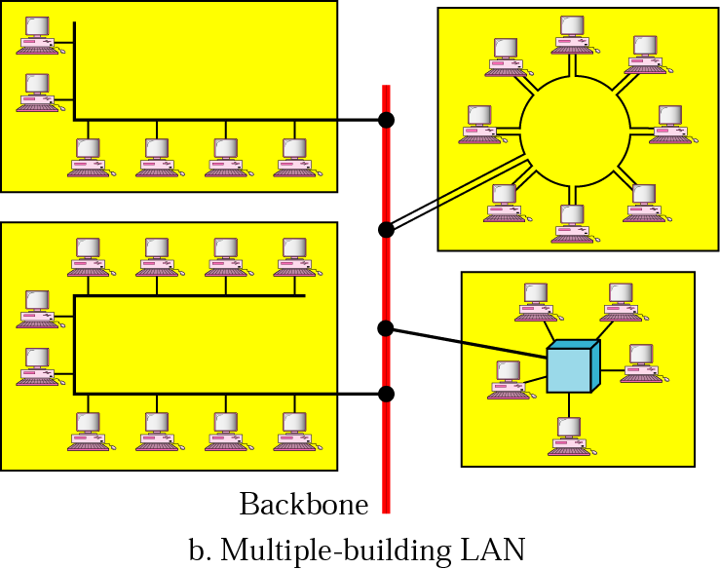
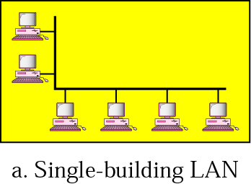
Local Area Networks
Network in a single office, building, or campus

Slide 23
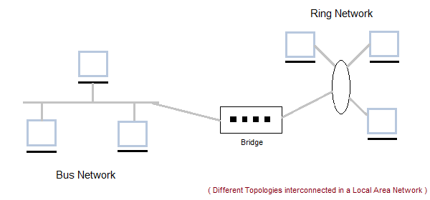
Network Categories
Local Area Network (LAN)

Slide 24
LAN
Local Area Network (LAN) is a group of computers connected to each other in a small area such as building, office.
LAN is used for connecting two or more personal computers through a communication medium such as twisted pair, coaxial cable, etc.
It is less costly as it is built with inexpensive hardware such as hubs, network adapters, and Ethernet cables.
The data is transferred at an extremely faster rate in Local Area Network.
Local Area Network provides higher security.

Slide 25
Characteristics of LAN
LAN's are private networks, not subject to tariffs or other regulatory controls.
LAN's operate at relatively high speed when compared to the typical WAN.
There are different types of Media Access Control methods in a LAN, the prominent ones are Ethernet, Token ring.
It connects computers in a single building, block or campus, i.e. they work in a restricted geographical area.

Slide 26
Applications of LAN
One of the computer in a network can become a server serving all the remaining computers called clients.
Software can be stored on the server and it can be used by the remaining clients.
Connecting Locally all the workstations in a building to let them communicate with each other locally without any internet access.
Sharing common resources like printers etc are some common applications of LAN.

Slide 27
Advantages of LAN
Resource Sharing: Computer resources like printers, modems, DVD-ROM drives and hard disks can be shared with the help of local area networks. This reduces cost and hardware purchases.
Software Applications Sharing: It is cheaper to use same software over network instead of purchasing separate licensed software for each client a network.
Easy and Cheap Communication: Data and messages can easily be transferred over networked computers.

Slide 28
Advantages of LAN
Centralized Data: The data of all network users can be saved on hard disk of the server computer. This will help users to use any workstation in a network to access their data. Because data is not stored on workstations locally.
Data Security: Since, data is stored on server computer centrally, it will be easy to manage data at only one place and the data will be more secure too.
Internet Sharing: Local Area Network provides the facility to share a single internet connection among all the LAN users. In Net Cafes, single internet connection sharing system keeps the internet expenses cheaper.

Slide 29
Disadvantages of LAN
High Setup Cost: Although the LAN will save cost over time due to shared computer resources, but the initial setup costs of installing Local Area Networks is high.
Privacy Violations: The LAN administrator has the rights to check personal data files of each and every LAN user. Moreover he can check the internet history and computer use history of the LAN user.

Slide 30
Disadvantages of LAN
Data Security Threat: Unauthorized users can access important data of an organization if centralized data repository is not secured properly by the LAN administrator.
LAN Maintenance Job: Local Area Network requires a LAN Administrator because, there are problems of software installations or hardware failures or cable disturbances in Local Area Network. A LAN Administrator is needed at this full time job.
Covers Limited Area: Local Area Network covers a small area like one office, one building or a group of nearby buildings.

Slide 31
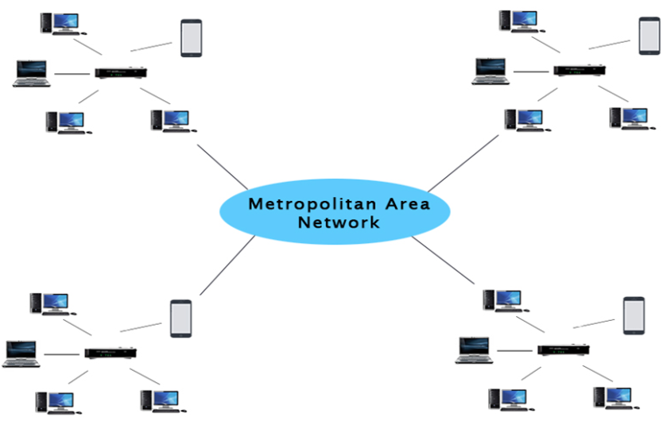
Metropolitan Area Network (MAN)

Slide 32
Metropolitan Area Network (MAN)
A metropolitan area network is a network that covers a larger geographic area by interconnecting a different LAN to form a larger network.
Government agencies use MAN to connect to the citizens and private industries.
In MAN, various LANs are connected to each other through a telephone exchange line.
The most widely used protocols in MAN are RS-232, Frame Relay, ATM, ISDN, OC-3, ADSL, etc.
It has a higher range than Local Area Network(LAN).

Slide 33
Characteristics of MAN
It generally covers towns and cities (50 km)
Communication medium used for MAN are optical fibers, cables etc.
Data rates adequate for distributed computing applications.

Slide 34
Applications of MAN
MAN is used in communication between the banks in a city.
It can be used in an Airline Reservation.
It can be used in a college within a city.
It can also be used for communication in the military.

Slide 35
Advantages of MAN
Extremely efficient and provide fast communication via high-speed carriers, such as fiber optic cables.
It provides a good back bone for large network and provides greater access to WANs.
The dual bus used in MAN helps the transmission of data in both directions simultaneously.
A MAN usually encompasses several blocks of a city or an entire city.

Slide 36
Disadvantages of MAN
More cable required for a MAN connection from one place to another.
It is difficult to make the system secure from hackers and industrial espionage (spying) graphical regions.

Slide 37
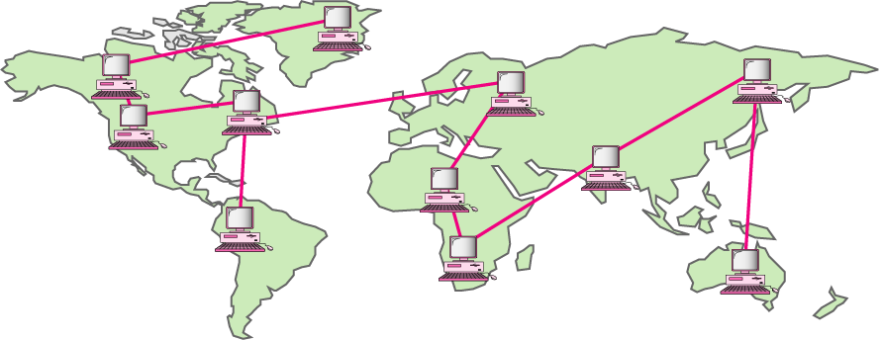
Wide Area Networks
A network that connects two or more local-area networks over a potentially large geographic distance
Network providing long-distance communication over a country, a continent, or the whole world

Slide 38
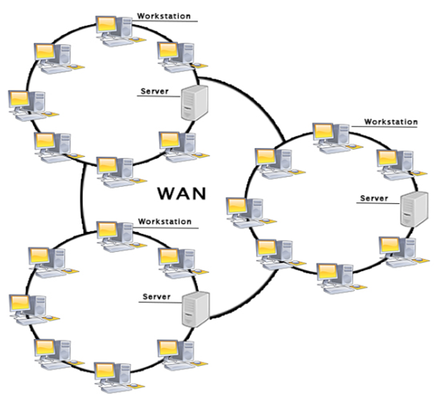
Wide Area Network (WAN)

Slide 39
Wide Area Network (WAN)
It is also called WAN. WAN can be private or it can be public leased network.
It is used for the network that covers large distance such as cover states of a country.
It is not easy to design and maintain.
Communication medium used by WAN are PSTN or Satellite links.
WAN operates on low data rates.

Slide 40
Examples for WAN
Mobile Broadband: A 4G network is widely used across a region or country.
Last mile: A telecom company is used to provide the internet services to the customers in hundreds of cities by connecting their home with fiber.
Private network: A bank provides a private network that connects the 44 offices. This network is made by using the telephone leased line provided by the telecom company.

Slide 41
Characteristics of WAN
It generally covers large distances(states, countries, continents).
Communication medium used are satellite, public telephone networks which are connected by routers.

Slide 42
Advantages of WAN
Geographical area: A Wide Area Network provides a large geographical area. Suppose if the branch of our office is in a different city then we can connect with them through WAN. The internet provides a leased line through which we can connect with another branch.
Centralized data: In case of WAN network, data is centralized. Therefore, we do not need to buy the emails, files or back up servers.
Get updated files: Software companies work on the live server. Therefore, the programmers get the updated files within seconds.

Slide 43
Advantages of WAN
Exchange messages: In a WAN network, messages are transmitted fast. The web application like Facebook, WhatsApp, Skype allows you to communicate with friends.
Sharing of software and resources: In WAN network, we can share the software and other resources like a hard drive, RAM.
Global business: We can do the business over the internet globally.
High bandwidth: If we use the leased lines for our company then this gives the high bandwidth. The high bandwidth increases the data transfer rate which in turn increases the productivity of our company.

Slide 44
Disadvantages of WAN
Security issue: A WAN network has more security issues as compared to LAN and MAN network as all the technologies are combined together that creates the security problem.
Needs Firewall & antivirus software: The data is transferred on the internet which can be changed or hacked by the hackers, so the firewall needs to be used. Some people can inject the virus in our system so antivirus is needed to protect from such a virus.
High Setup cost: An installation cost of the WAN network is high as it involves the purchasing of routers, switches.
Troubleshooting problems: It covers a large area so fixing the problem is difficult.

Slide 45
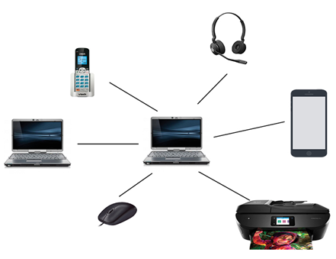
Personal Area Network (PAN)

Slide 46
Personal Area Network (PAN)
Personal Area Network is a network arranged within an individual person, typically within a range of 10 meters.
Personal Area Network is used for connecting the computer devices of personal use is known as Personal Area Network.
Thomas Zimmerman was the first research scientist to bring the idea of the Personal Area Network.
Personal Area Network covers an area of 30 feet.
Personal computer devices that are used to develop the personal area network are the laptop, mobile phones, media player and play stations.

Slide 47
Examples of PAN
Body Area Network: Body Area Network is a network that moves with a person. For example, a mobile network moves with a person. Suppose a person establishes a network connection and then creates a connection with another device to share the information.
Offline Network: An offline network can be created inside the home, so it is also known as a home network. A home network is designed to integrate the devices such as printers, computer, television but they are not connected to the internet.
Small Home Office: It is used to connect a variety of devices to the internet and to a corporate network using a VPN

Slide 48
Data Transmission Modes
The data is transmitted from one device to another device through a transmission mode.
The transmission mode decides the direction of data in which the data needs to travel to reach the receiver system or node.
The transmission mode is divided into three
categories:
1. Simplex 2. Half-Duplex 3. Full-Duplex

Slide 49
Data Transmission Modes
The data is transmitted from one device to another device through a transmission mode.
The transmission mode decides the direction of data in which the data needs to travel to reach the receiver system or node.
The transmission mode is divided into three
categories:
1. Simplex 2. Half-Duplex 3. Full-Duplex

Slide 50
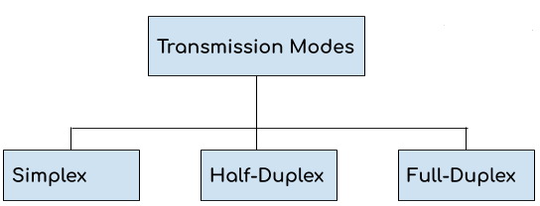
Data Transmission Modes

Slide 51
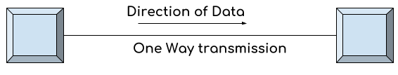
Simplex Mode
1. In simplex mode the data transmits in one direction only, from one system to another system. 2. The sender device that sends data can only send data and cannot receive it. On the other hand the receiver device can only receive the data and cannot send it. 3. Television is an example of simplex mode transmission as the broadcast sends signals to our TV but never receives signals back from our TV. This is a unidirectional transmission.

Slide 52
Simplex Mode
Advantages of Simplex Mode: The full capacity of the transmission medium is utilized as the transmission is one way and cannot have traffic issues.
Disadvantages of Simplex Mode: No bidirectional communication is possible. Two devices cannot communicate with each other using simplex mode of transmission.

Slide 53
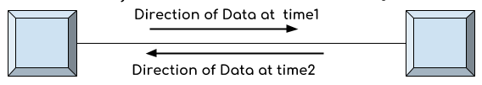
Half-Duplex Mode
1. In half duplex mode transmission can be done both ways which means if two systems are connected with half-duplex mode of transmission, they both can send and receive data but not at the same time. 2. If one device is sending data then other device cannot send data until it receives the data which is already in transmission. You can say that the communication is not simultaneous. 3. The radio communication device that our soldiers use at the battle fields are the examples of half duplex mode transmission as they send message and then say over and then the person on other hand send his message and this way they communicate but not simultaneously like we used to do on mobile.

Slide 54
Half-Duplex Mode
Advantages of Half-Duplex mode: Both devices can send and receive data. Whole bandwidth can be utilized as at a time only one signal transmits.
Disadvantages of Half-Duplex mode: The disadvantage in half duplex mode is that the other device cannot send data until it receives the data which is already in transmission, this can cause delays to the communication.

Slide 55
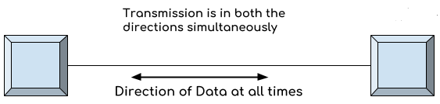
Full-Duplex Mode
1. In full duplex mode both the connected devices can send and receive data simultaneously. The mobile phone we use is an example of full duplex mode where we can communicate simultaneously. 2. Both the devices can send and receive the data at the same time.

Slide 56
Full-Duplex Mode
Advantages of Full Duplex mode: No delays in communication as both can send and receive data simultaneously.
Disadvantages of Full Duplex mode: No proper bandwidth utilization as the same line is used for sending and receiving data at the same time.

Slide 57

Network Topology- Types

Slide 58
Network Topology- Types
Topology: physical or logical arrangement of devices
Point-to-point
Mesh
Star
Bus
Ring
Hybrid

Slide 59
Point-to-Point Connection
Point to Point - single transmitter and receiver

Slide 60
Fully Connected Mesh Topology
E
A
D
B
C

Slide 61
Fully Connected Mesh Topology

Slide 62
Fully Connected Mesh Network
If there is n nodes, then n(n-1) physical links are needed for fully connected mesh topology
If a link communicates both direction (duplex mode), then n(n-1)/2 physical links are needed for fully connected mesh topology
A node needs (n-1) ports to connect with other nodes

Slide 63
Fully Connected Mesh Topology
Pros:
Dedicated links
Robustness
Privacy
Easy to identify fault
Cons:
A lot of cabling
I/O ports
Difficult to move

Slide 64
Star Topology
A configuration that centers around one node to which all others are connected and through which all messages are sent
A
D
Hub
Drop
B
C
Drop

Slide 65
Star Topology
A
D
Switch
B
C

Slide 66
Star Topology
A
D
Hub
B
C

Slide 67
Star Topology
Pros:
One I/O port per device
Little cabling
Easy to install
Robustness
Easy to identify fault
Cons:
Single point of failure
More cabling still required
Hub

Slide 68
Bus Topology
Drop line
Tap
Terminator

Slide 69
Bus Topology
All nodes are connected to a single communication line that carries messages in both directions
A
B
C
D

Slide 70
Bus Topology

Slide 71
Bus Topology
Pros:
Little cabling
Easy to install
Cons:
Difficult to modify
Difficult to isolate fault
Break in the bus cable stops all transmission

Slide 72
Ring Topology
A configuration that connects all nodes in a closed loop on which messages travel in one direction
C
D
B
A

Slide 73
Ring Topology

Slide 74
Ring Topology
Pros:
Easy to install
Easy to identify fault
Cons:
Delay in large ring
Break in the ring stops all transmission

Slide 75
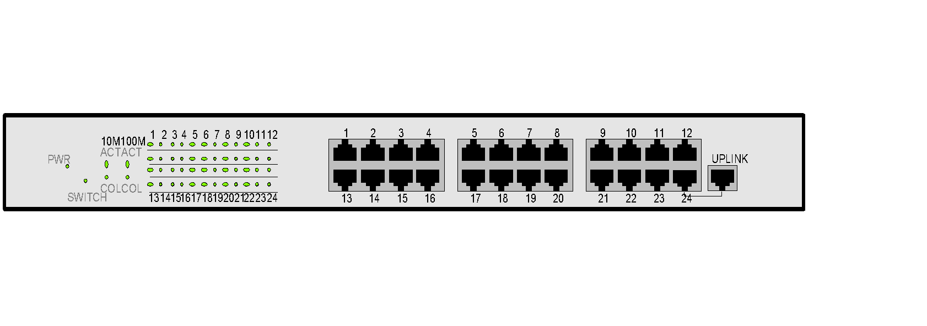
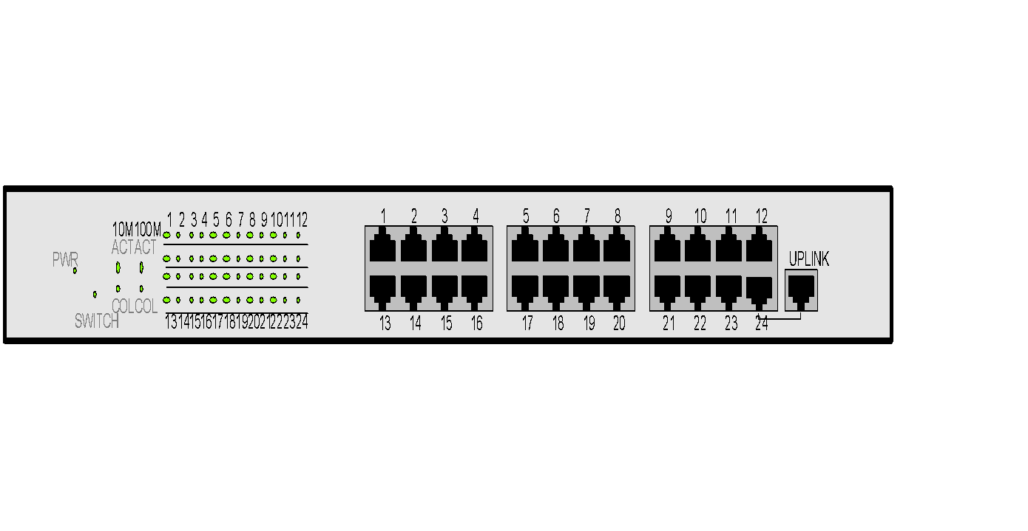
Hybrid Topologies

Slide 76
Network Topology -Comparison
Parameters | Bus | Ring | Star | Mesh
Network Performance | Small | Small or Large | Small | Small
Cable Length Requirement | Less | Neither less nor | More | More
Traffic | Less | High | Medium | No
Dataflow Efficiency | More | Neither less nor more | More | More
Failure | Easy to solve | Difficult to solve | Easy to solve except hub/switch fails | Easy to solve
Cost | Low | High | High | High

Slide 77
Session 2
Types of Packet Switched networks
- Datagram networks and virtual Circuit
networks
- Structure of Circuit and Packet Switches
- Comparisons
Protocols and standards
Standards Organizations, Forums and
Regulatory agencies
Internet Standards
RFC

Slide 78
Switching
Notes:
‹#›

Slide 79
Switching
1 INTRODUCTION
2 CIRCUIT-SWITCHED NETWORK
3 PACKET-SWITCHING
Notes:
8.#

Slide 80
INTRODUCTION TO SWITCHING
Network connections rely on switches.
Switches operate at the
Physical layer
Data link layer
Network layer
Notes:
8.#

Slide 81
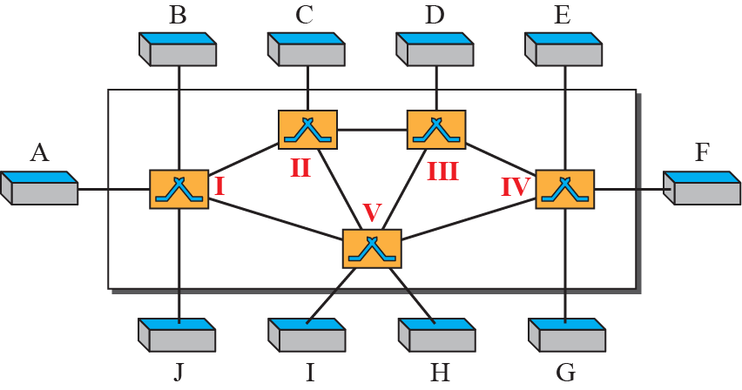
Switched network
Notes:
8.#

Slide 82
Methods of Switching
These are the two most common methods of switching:
circuit switching
packet switching
Packet switching can further be divided into two subcategories,
virtual-circuit approach and
datagram approach
Notes:
8.#

Slide 83
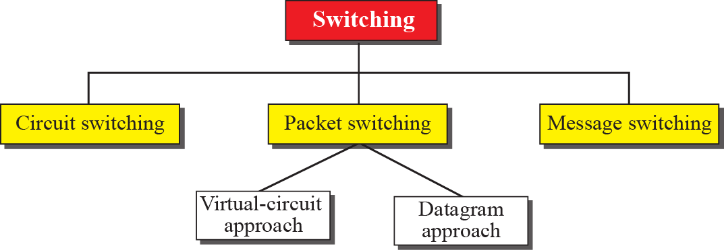
Taxonomy of switched networks
Notes:
8.#

Slide 84

2 CIRCUIT-SWITCHED NETWORKS
A circuit-switched network consists of a set of switches connected by physical links.
Circuit-switches operate at the physical layer.
A circuit-switched network creates a dedicated path to complete a link between the sender and receiver.
telephone switch
Notes:
8.#

Slide 85
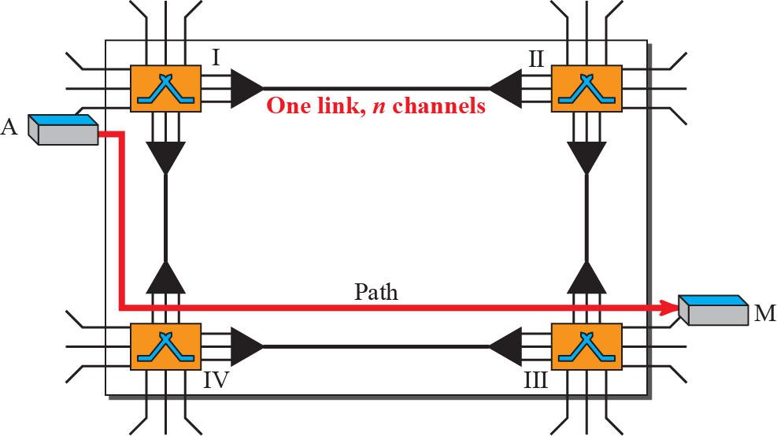
Figure 3: A trivial circuit-switched network
Notes:
8.#

Slide 86
Example 1
As a trivial example, let us use a circuit-switched network to connect eight telephones in a small area. Communication is through 4-kHz voice channels. We assume that each link uses FDM to connect a maximum of two voice channels. The bandwidth of each link is then 8 kHz. Figure 4 shows the situation. Telephone 1 is connected to telephone 7; 2 to 5; 3 to 8; and 4 to 6. Of course the situation may change when new connections are made. The switch controls the connections.

Slide 87
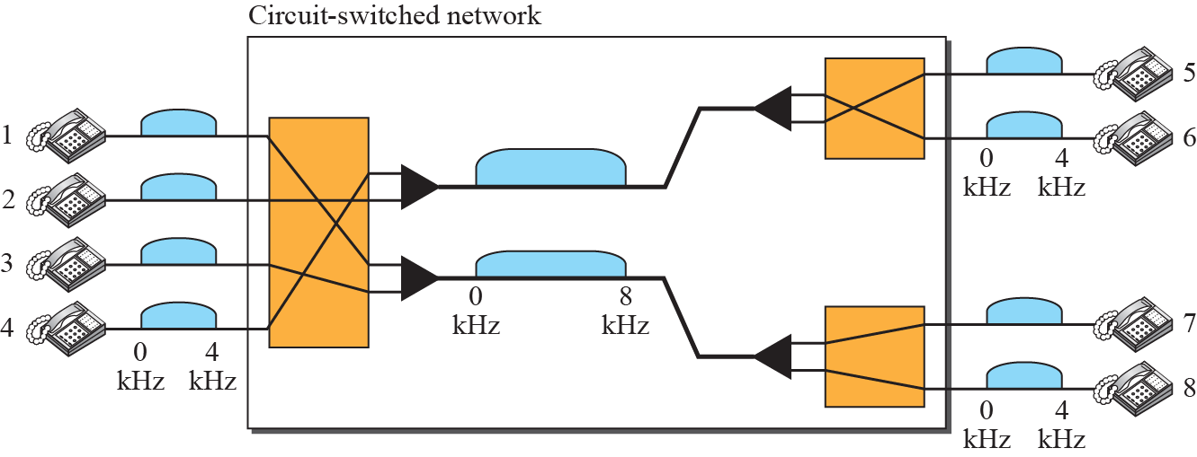
Circuit-switched network used in Example 1
Notes:
8.#

Slide 88
Example 2
As another example, consider a circuit-switched network that connects computers in two remote offices of a private company. The offices are connected using a T-1 line leased from a communication service provider. There are two 4 × 8 (4 inputs and 8 outputs) switches in this network. For each switch, four output ports are folded into the input ports to allow communication between computers in the same office. Four other output ports allow communication between the two offices. Figure 5 shows the situation.

Slide 89
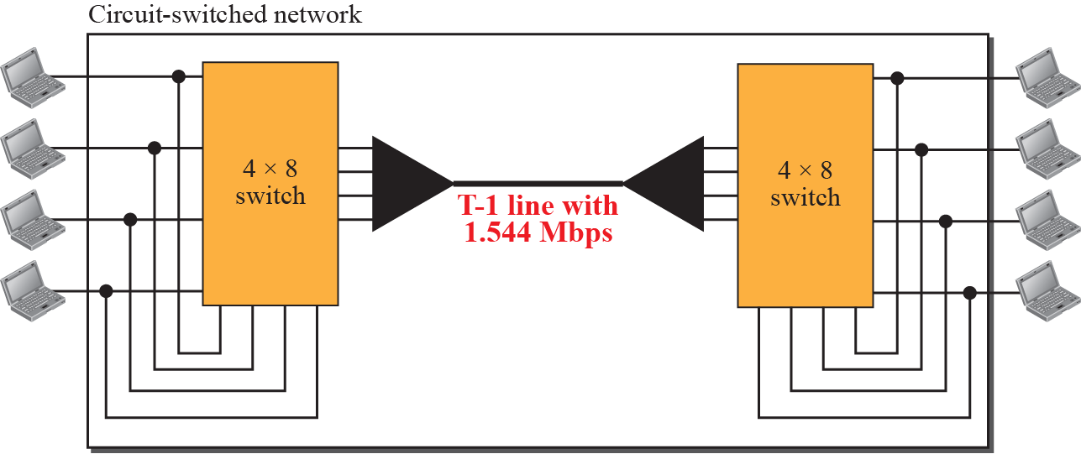
Circuit-switched network used in Example 2
Notes:
8.#

Slide 90
Three Phases
The actual communication in a circuit-switched network requires three phases:
connection setup,
data transfer, and
connection teardown.
Notes:
8.#

Slide 91
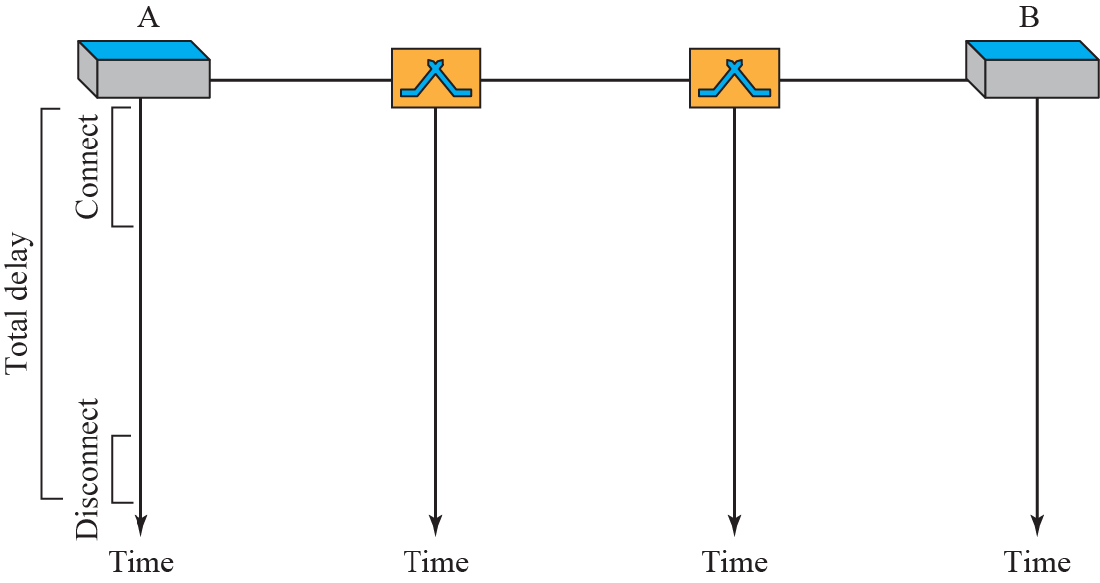

circuit-switched network three phases
Notes:
8.#

Slide 92
Efficiency
It can be argued that circuit-switched networks are not as efficient as the other two types of networks because resources are allocated during the entire duration of the connection.
These resources are unavailable to other connections. In a telephone network, people normally terminate the communication when they have finished their conversation.
Notes:
8.#

Slide 93
Delay
During data transfer the data are not delayed at each switch; the resources are allocated for the duration of the connection.
Notes:
8.#

Slide 94
Delay in a circuit-switched network
Notes:
8.#

Slide 95
3 PACKET SWITCHING
A packet-switched network divides the data into packets of fixed or variable size.
The size of the packet is determined by the network and the governing protocol.
Packet switched networks are classified as
a) Datagram Networks
b) Virtual circuit Networks
Notes:
8.#

Slide 96

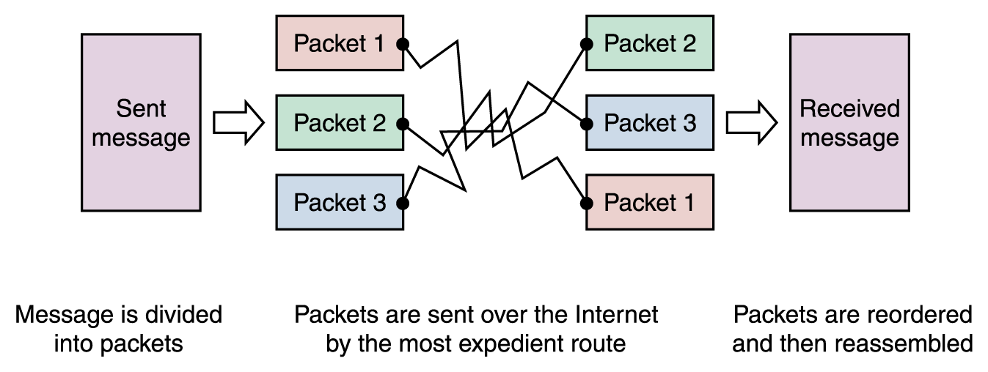
Packet
Router
PACKET SWITCHING

Slide 97
Datagram Networks
In a datagram network, each packet is treated independently of all others.
In a datagram network, each packet is treated independently of all others.
A datagram network operates at the Network layer.
Even if a packet is part of a multipacket transmission, the network treats packets as though they existed alone.
Notes:
8.#

Slide 98
Datagram Networks
Even if a packet is part of a multipacket transmission, the network treats each packet as an independent message.
Each packet of one message can travel a different route towards their final destination.
Packets using this approach are referred to as datagrams.
Notes:
8.#

Slide 99
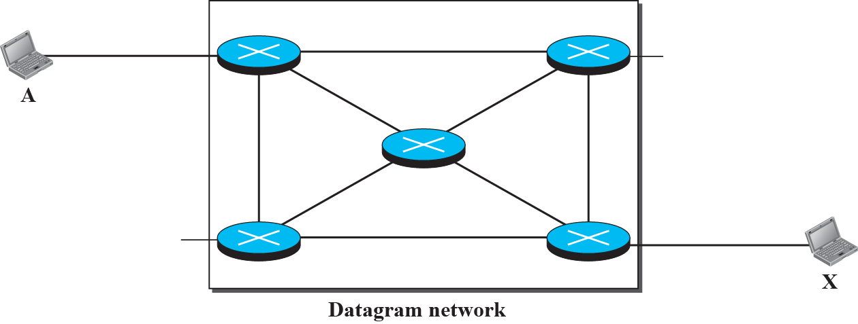
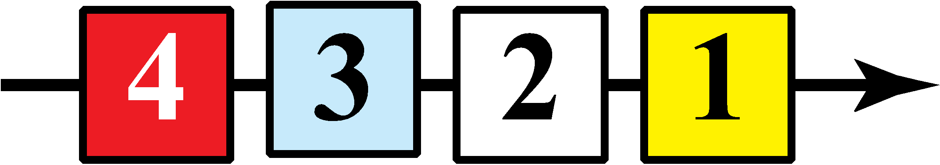






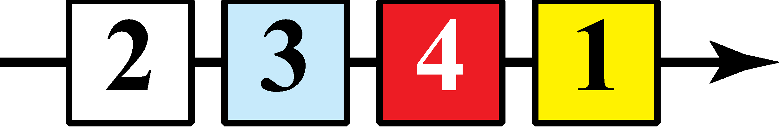

A Datagram network with four 3-level switches
Notes:
8.#

Slide 100
Datagram Networks
All packets have a destination address in the header.
The packets have a destination address in the header.
The destination address for each datagram is used at a router to forward the message towards its final destination.
The packet header contains a sequence number in the header so it can be ordered at the destination.
Notes:
8.#

Slide 101
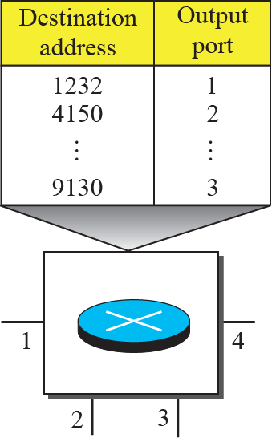
Routing table in a datagram network
Notes:
8.#

Slide 102
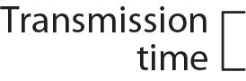
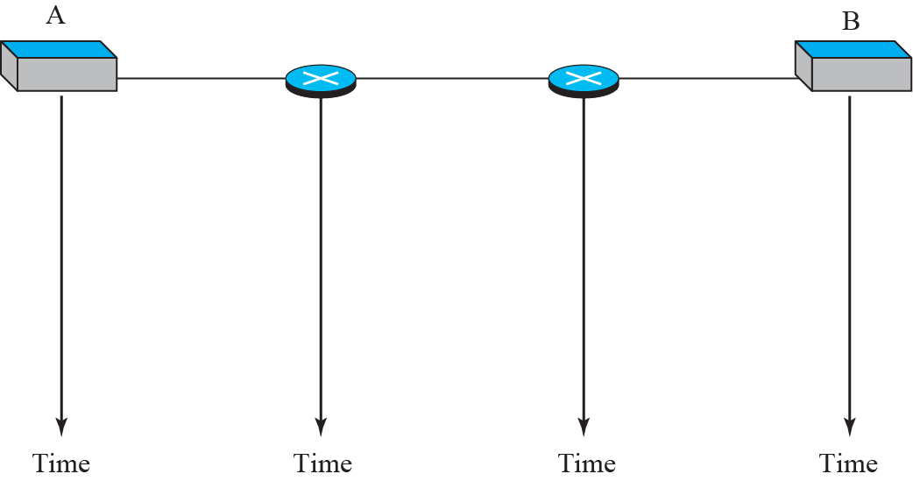

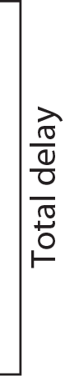


Delays in a datagram network (compare to next slide)
Notes:
8.#

Slide 103
Compare the datagram network to the circuit-switched network
Notes:
8.#

Slide 104
3.1 Virtual-Circuit Networks
A virtual-circuit network is a cross between a circuit-switched network and a datagram network.
The virtual-circuit shares characteristics of both.
The virtual-circuit network operates at the data-link layer.
The packets for a virtual circuit network are known as frames.
Notes:
8.#

Slide 105
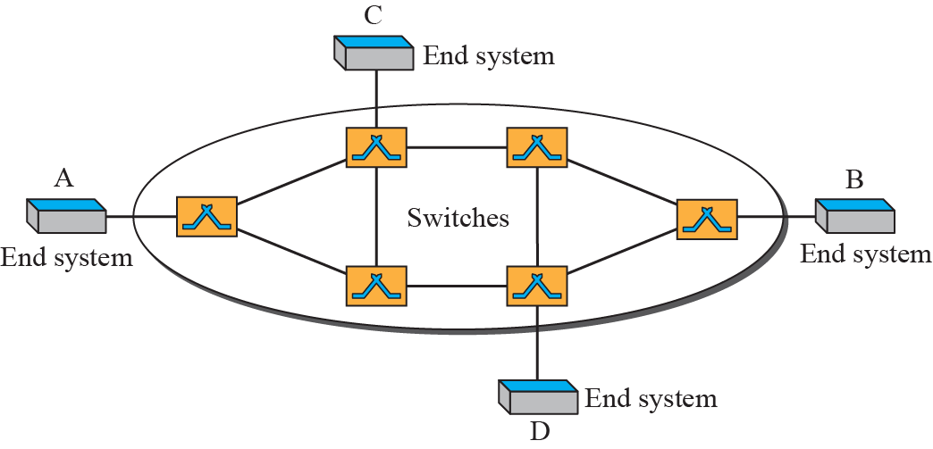
Virtual-circuit network
Notes:
8.#

Slide 106
3.2 Virtual-Circuit Networks
A virtual-circuit network uses a series of special temporary addresses known as virtual circuit identifiers (VCI).
The VCI at each switch, is used to advance the frame towards its final destination.
Notes:
8.#

Slide 107
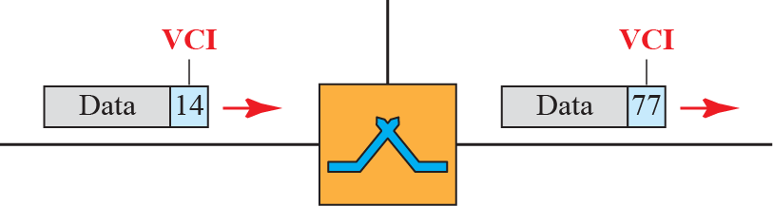
Virtual-circuit identifier (compare the VCI to a Datagram destination address)
Notes:
8.#

Slide 108
3.2 Virtual-Circuit Networks
The switch has a table with 4 columns:
a) Inputs half
Input Port Number
Input VCI
b) Outputs half
Output Port Number
Output VCI
Notes:
8.#

Slide 109
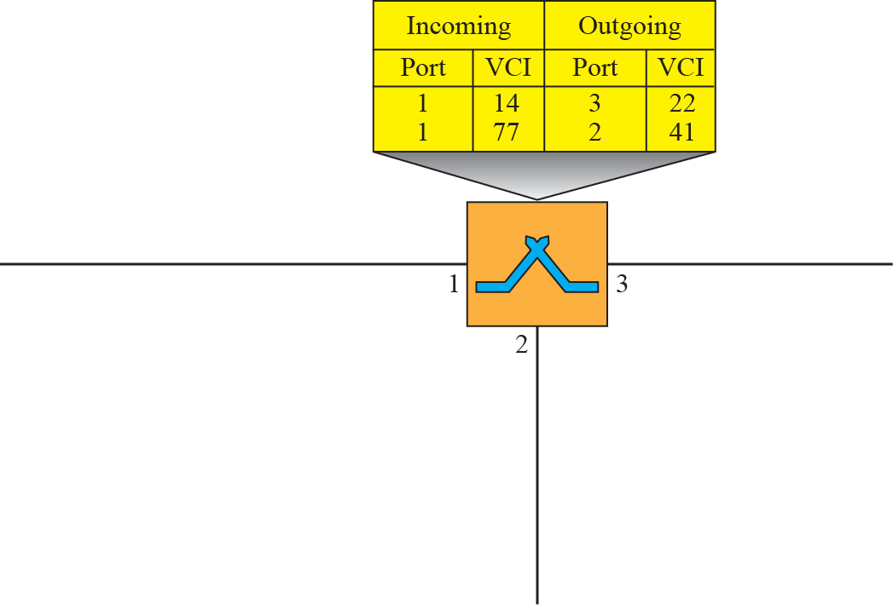



Switch and table for a virtual-circuit network
Notes:
8.#

Slide 110
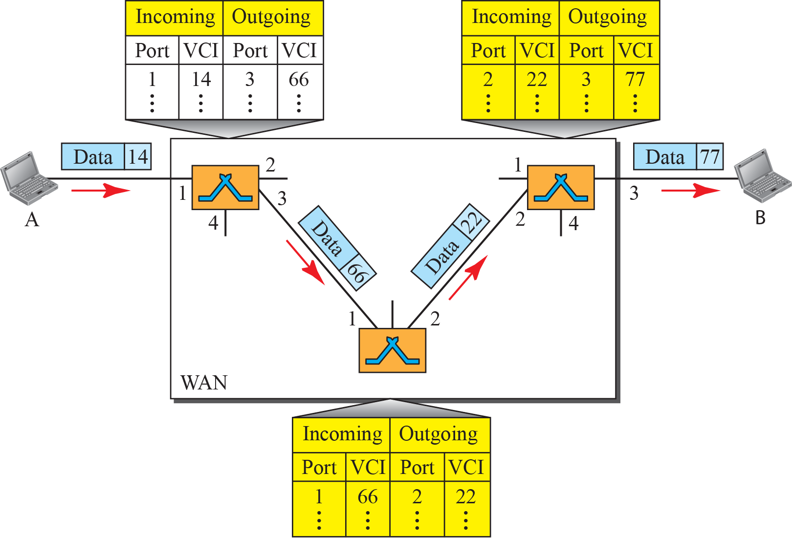
Source-to-destination data transfer in a circuit-switch network
Notes:
8.#

Slide 111
Virtual Circuit Networks
The VCN behaves like a circuit switched net because there is a setup phase to establish the VCI entries in the switch table.
There is also a data transfer phase and teardown phase.
.
Notes:
8.#

Slide 112
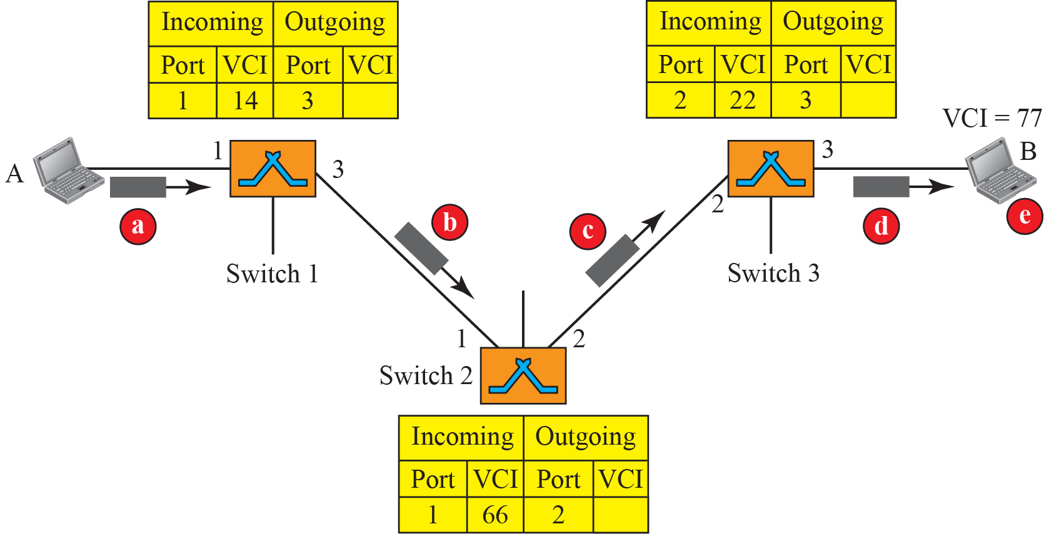
Setup request in a virtual-circuit network
All nodes have a VCI
Notes:
8.#

Slide 113
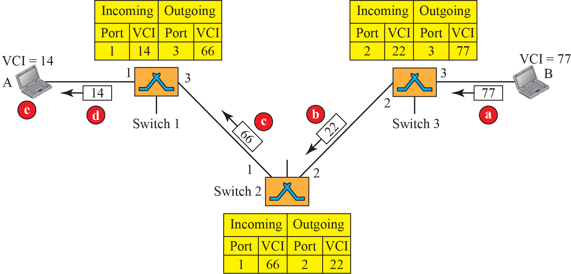
Setup acknowledgment in a virtual-circuit network
Notes:
8.#

Slide 114
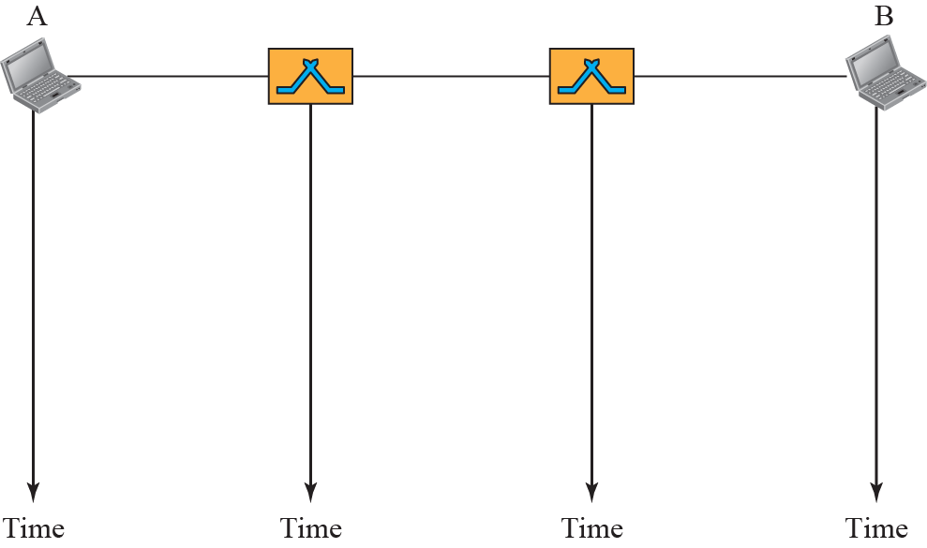


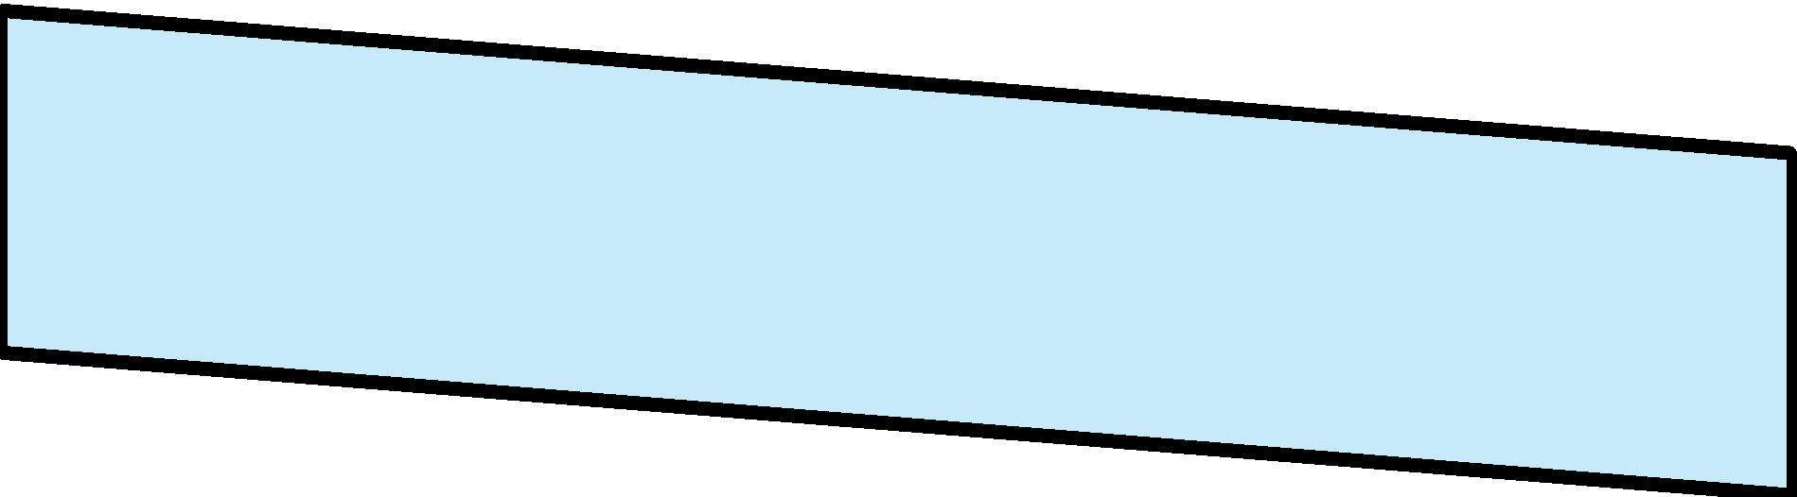

Delay in a virtual-circuit network
Notes:
8.#

Slide 115
Comparison Chart
BASIS | CIRCUIT SWITCHING | PACKET SWITCHING
Orientation | Connection oriented. | Connectionless.
Purpose | Initially designed for Voice communication. | Initially designed for Data Transmission.
Flexibility | Inflexible, because once a path is set all parts of a transmission follows the same path. | Flexible, because a route is created for each packet to travel to the destination.
Order | Message is received in the order, sent from the source. | Packets of a message are received out of order and assembled at the destination.
Technology/Approach | Circuit switching can be achieved using two technologies, either Space Division Switching or Time-Division Switching. | Packet Switching has two approaches Datagram Approach and Virtual Circuit Approach.
Layers | Circuit Switching is implemented at Physical Layer. | Packet Switching is implemented at Network Layer.

Slide 116
Protocols & Standards
Protocols
Communicating worldwide will not be possible if there were no fixed 'standards' that will govern the way user communicates for data as well as the way our devices treat those data
For proper communication, entities in different systems must speak the same language
- there must be mutually acceptable conventions and rules about the content, timing and underlying mechanisms
Those conventions and associated rules are referred as “PROTOCOLS”

Slide 117
Protocols
Network Protocols:
“Network protocols are sets of established rules that dictate how to format, transmit and receive data so computer network devices -- from servers and routers to endpoints -- can communicate regardless of the differences in their underlying infrastructures, designs or standards”

Slide 118
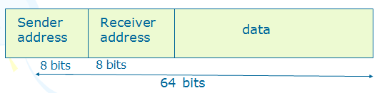
Elements of Protocols
i) Syntax: The structure or format of the data.
Eg. A simple protocol;
ii) Semantics: - Refers to the meaning of each
section of bits.
- how is a particular pattern to be interpreted, and what action is to be taken based on that interpretation.
Eg. Does an address identify the route to be taken or the final of the message?

Slide 119
Elements of Protocols
iii) Timing
Refers to two characteristics:
When data to be sent
How fast it can be sent
Eg. If a sender produces data at 100 Mbps but the receiver can process data at only 1 Mbps, the transmission will overload the receiver and data will be largely lost.

Slide 120
Characteristics of protocol
a) Direct / indirect
Communication between two entities maybe
direct or indirect.
i) point-to-point link
- connection provides a dedicated link between two devices
- the entities in these systems may
communicate directly that is data and
control information pass directly
between entities with no intervening
active agent.

Slide 121
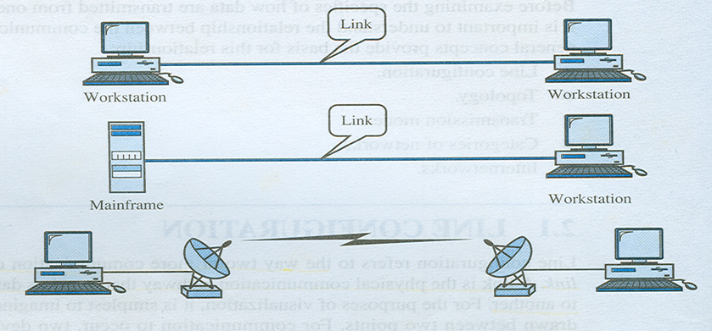
Characteristics of protocol

Slide 122
Characteristics of protocol
ii) multipoint link
- connection more than two devices can share a single link
- The entities must be concerned with the issue of access control and making the protocol more complex.

Slide 123
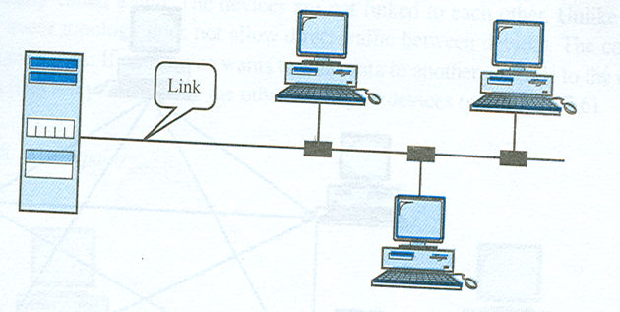
Characteristics of protocol

Slide 124
Characteristics of protocol
b) Monolithic / structured
- The task of communication between entities on different systems is too complex to be handled as a unit.
Eg. An electronic mail package running on two computers connected by a synchronous HDLC link. To be structured, the package would need to include all of the HDLC logic. If the connection were over a packet-switched network, the packaged would still need the HDLC logic to attach it to the network.

Slide 125
Characteristics of protocol
c) Symmetric / asymmetric
- Symmetric is the most use in protocol and involve communication between peer entities.
- Asymmetry may be dictated by the logic of an exchange (eg; client and a server process) the desire to keep one of the entities or systems as simple as possible.

Slide 126
Characteristics of protocol
d) Standard / nonstandard
If K different kinds of information sources have to communicate with L types of information receivers, as many as K x L different protocols are needed without standards and a total of 2 x K x L implementations are required
If all systems shared a common protocol, only K+L implementations would be needed.

Slide 127
Standards
Standards are essential in creating and maintaining an open and competitive market for equipment manufacturers and also in guaranteeing national and international interoperability of data and telecommunications technology and processes.
They provide guidelines to manufacturers, vendors, government agencies, and other service providers to ensure the kind of interconnectivity necessary in today's marketplace and in international communication.

Slide 128
Standards
Data communication standards fall into two categories: de facto ( meaning "by fact" or "by convention") and de jure (meaning "by law" and "by regulation").
De facto. Standards that have not been approved by an organized body but have been adopted as standards through widespread use are de facto standards. De facto standards are often established originally by manufacturers that seek to define the functionality of a new product or technology.
De jure. De jure standards are those that have been legislated by an officially recognized body.

Slide 129
Standards and Organizations
Standards are developed through cooperation of standards creation committees, forums and government regulatory agencies.
Some of the standards establishment Organizations are:
International Standards Organization (ISO) http://www.iso.org/
International Telecommunications Union-Telecommunication Standards Sector (ITU-T). http://www.itu.int/ITU-T
American National Standard Institute (ANSI).
Institute of Electrical and Electronics Engineers (IEEE). http://www.ieee.gov/
Electronic Industries Association (EIA).

Slide 130
Forums
To facilitate the standardization process, many special-interest groups have developed forums made up of representatives from interested corporations.
The forums work with universities and users to test, evaluate and standardize new technologies
The forums are able to speed acceptance and use of those technologies in the telecommuni --cations community

Slide 131
Forums
The forums present their conclusions to the standards bodies.
Some important forums for the telecommunications industry
include the following:
Frame Relay Forum. The Frame Relay Forum was formed by digital equipment Corporation, Northern Telecom, Cisco, and StrataCom to promote the acceptance and implementation of frame relay. Today, it has around 40 members representing North America, Europe, and the Pacific rim. Issues under Review include flow control. encapsulation, translation, and multicasting. the forum's results are submitted to the ISO.
ATM Forum. http://www.atmforum.com/ The ATM Forum provides acceptance and use of Asynchronous Transfer Mode (ATM) technology. The ATM Forum is made up of Customer Premises Equipment (e.g., PBX systems ) vendors and Central Office (e.g., telephone exchange) providers. It is concerned with the standardization of service to ensure interoperability.

Slide 132
Regulatory Agencies
All communications technology is subject to regulation by government agencies such as Federal Communication Commission (FCC) in the United States.
The purpose of these agencies is to protect the public interest by regulating radio, television, and wire/cable communications. Federal Communications Commission (FCC)
http://www.fcc.gov/
The Federal Communications Commission (FCC) has authority over interstate and international commerce as it relates to communications

Slide 133
RFCs
RFCs go through maturity levels and are categorized according to their requirement level
Maturity Levels An RFC, during its lifetime, falls into one of six maturity levels: proposed standard, draft standard, Internet standard, historic, experimental, and Informational.
Proposed Standard. A proposed standard is a specification that is stable, well understood, and of sufficient interest to the internet community. At this level, the specification is usually tested and implemented by several different programs.

Slide 134
RFCs
Draft Standard. A proposed standard is elevated to draft standard status after atleast two successful independent and interoperable implementations. Barring difficulties, a draft standard, with modifications if specific problems are encountered, normally becomes an internet standard.
Internet Standard. A draft standard reaches Internet standard after demonstrations of successful implementation.
Historic. The Historic RFCs are significant from a historical perspective. They either have been superseded by later specifications or have never passed the necessary maturity levels to become an internet standard.
Experimental. An RFC classified as experimental describes work related to an experimental situation that does not affect the operation of the internet. Such an RFC should not be implemented in any functional Internet service

Slide 135
RFCs
Informational. An RFC classified as informational contains general, historical, or tutorial information related to the Internet. It is usually written by someone in a non-Internet organization, such as a vendor.
RFC Requirement Levels RFCs are classified into 5 Requirement Levels: required, recommended, elective, limited use and not recommended.

Slide 136
RFCs
Required. An RFC is labeled required if it must be implemented by all Internet systems to achieve minimum conformance. For example, IP and ICMP are required protocols.
Recommended. An RFC labeled recommended is not required for minimum conformance; it is recommended because of its usefulness. For example, FTP and TELNET are recommended protocols.
Elective. An RFC labeled elective is not required and not recommended. However, a system can use it for its own benefit.
Limited Use. An RFC labeled limited use should be used only in limited situations. Most of the experimental RFCs fall under this category.
Not recommended. An RFC labeled not recommended is inappropriate for general use. Normally a historic (obsolete) RFC may fall under this category.

Slide 137
Protocol Suite
A set of cooperating network protocols is called a protocol suite.
For example, the TCP/IP suite includes numerous protocols across layers -- such as the data, network, transport and application layers -- working together to enable internet connectivity.

Slide 138
Types of Network Protocols
Networks have three types of protocols
Communication, such as Ethernet
Management, such as the Simple Mail Transfer Protocol (SMTP); and
Security, such as Secure Shell (SSH)
Falling into these three broad categories are thousands of network protocols that uniformly handle an extensive variety of defined tasks

Slide 139
Implementation of Protocols
They are coded within software, either
a part of the computer's operating system (OS) or
as an application, or
implemented within the computer's hardware.
Most modern OSs possess built-in software services that implement some network protocols
Applications, such as web browsers, implement protocols in the form of software libraries
TCP/IP and routing protocol support is implemented in direct hardware for enhanced performance

Slide 140
Session 5
OSI Model - Layered architecture
Interfaces between layers
Encapsulation
Functions of Each Layer in the OSI Model

Slide 141
General protocol architecture principles
Layered structure
Protocol stack
Each layer provides services to upper layer; expect services from lower one
Layer interfaces should be well-defined
Peer entities communicate using their own protocol
peer-to-peer protocols
independent of protocols at other layers
if one protocol changes, other protocols should not get affected

Slide 142
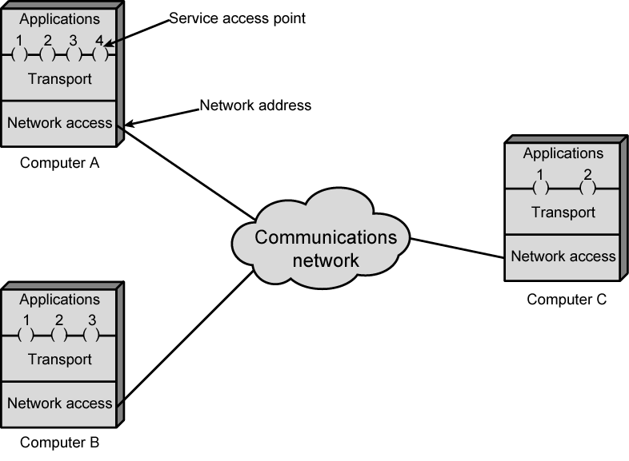
Protocol Architectures and Networks
or ports

Slide 143
Protocol Data Unit (PDU)
User data is passed from layer to layer
Control information is added/removed to/from user data at each layer
Header (and sometimes trailer)
each layer has a different header/trailer
Data + header + trailer = PDU (Protocol Data Unit)
This is basically what we call packet
each layer has a different PDU

Slide 144
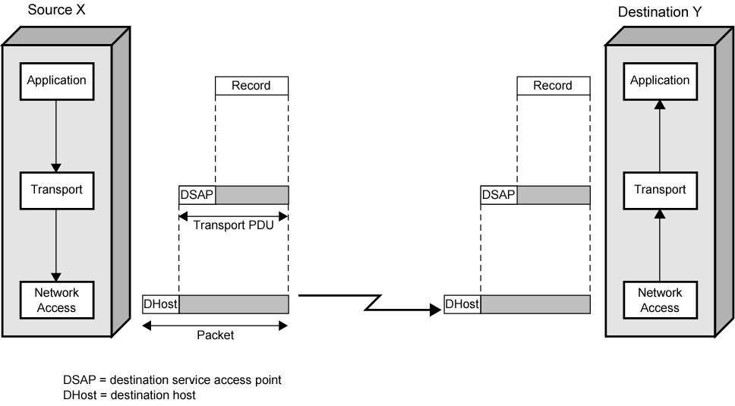
Operation of a Protocol Architecture
Transport Header
Transport Header
Network Header
Network Header
(Network PDU)

Slide 145
Standard Protocol Architectures
Common set of conventions
Nonstandard vs. standard protocols
Nonstandard: K sources and L receivers lead to K*L different protocols
If common protocol used, we design only once
Products from different vendors interoperate
Customers do not stick to a specific vendor
If a common standard is not implemented in a product, then that product’s market is limited; customers like standard products

Slide 146
Standard Protocol Architectures
Two approaches (standard)
OSI Reference model
never used widely
but well known
TCP/IP protocol suite
Most widely used
Another approach (proprietary)
IBM’s Systems Network Architecture (SNA)

Slide 147
OSI Reference Model
Open Systems Interconnection (OSI)
Reference model
provides a general framework for standardization
defines a set of layers and services provided by each layer
one or more protocols can be developed for each layer
Developed by the International Organization for Standardization (ISO)
also published by ITU-T (International Telecommunications Union)

Slide 148
OSI Reference Model
A layered model
Seven layers – seven has been presented as the optimal number of layer
Delivered too late (published in 1984)!
by that time TCP/IP started to become the de facto standard
Although no OSI-based protocol survived, the model is still valid (in the textbooks)
For Data Link Layer (that we will see later) OSI protocols are still valid

Slide 149
OSI - The Layer Model
Each layer performs a subset of the required communication functions
Each layer relies on the next lower layer to perform more primitive functions
Each layer provides services to the next higher layer
Changes in one layer should not require changes in other layers

Slide 150

OSI as Framework for Standardization
layer functionalities are described by ISO; different standards can be developed based on these functionalities

Slide 151

Layer Specific Standards

Slide 152
Elements of Standardization
Protocol specification
Operates between the same layer on two systems
May involve different platforms
Protocol specification must be precise
Format of data units
Semantics of all fields
Service definition
Functional description of what is provided to the next upper layer
Addressing
Referenced by SAPs

Slide 153

Seven layers of the OSI model

Slide 154

The OSI Architecture

Slide 155


Layer to Layer Communication

Slide 156
Physical Layer
There is no interpretation at this level, a stream of 1’s and 0’s are put into a form convenient for transmission.
Waves (with little regard for their information content) are sent and received.
This level is the most hardware oriented. It includes specifications about
NIC card speeds
Types and lengths of cable
Voltage characteristics (range, level or edge)
Etc.
The physical layer involves protocols for actual transmission
Ethernet
FDDI
RS232
ATM
These protocols also involve the interface with the next higher layer

Slide 157
Data Link Layer (DLL)
At this layer one begins to consider bytes instead of just bits, one examines some of the information content of the signal (at least the address and some of the error detection sequencing)
Recall that bridges operate at this level
They know where a packet is headed.
They know whether or not it has been involved in a collision.
Bit stuffing occurs at this level.
Data packets are encoded and decoded into bits.
It directs packets and handles errors from the physical layer

Slide 158
Data Link Layer (DLL)
It handles synchronization (timing).
It must know where one bit ends and the next one begins.
It must know where one byte ends and the next one begins
The data link layer is divided into two sub-layers:
The MAC (Media Access Control) sub-layer: takes the signal from or puts the signal onto the transmission line (“touches” physical layer).
The LLC (Logical Link Control) sub-layer: starts to interpret the signal as data, includes timing (synchronization) and error checking.

Slide 159
Network Layer
The router acted at this layer.
One of the main functions of the layer is routing. Store and forward are network layer functions.
In a connection-oriented scheme, the virtual circuit is established at the network layer.
Building the routing tables, troubleshooting the routing tables when there is a lot of traffic or if a connection goes down.
The network layer also gathers related packets (packet sequencing).

Slide 160
Transport Layer
As stated before, Layer 4 is the dividing line between inter-computer transactions and intra-computer transactions.
Layer 4 manages end-to-end verification.
The lower layers make a “best effort” but if data is lost so be it. Layer 4 must ensure that the information was received intact.
It does a higher-order error-checking.
The transfer should be “transparent.” The higher layers do not know the data came from another computer.
At a node Layer 3 collects associated packets if one was dropped it may throw them all away.
It is the responsibility of the source’s Layer 4 to look for some acknowledgement that all packets arrived. If no acknowledgment is received, it should retransmit

Slide 161
Session Layer
Recall when discussing connection-oriented schemes, we mentioned the idea of a “session.”
It is an agreement between a source and destination to communicate.
This layer establishes, manages and terminates sessions between applications (they could be on the same computer or on different computers).

Slide 162
Presentation Layer
This layer provides independence from differences in data representation (e.g., encryption) by translating from application to network format, and vice versa.
The presentation layer works to transform data into the form that the application layer can accept.
This layer formats and encrypts data to be sent across a network, providing freedom from compatibility problems. It is sometimes called the “syntax layer.”

Slide 163
Application Layer
This layer supports application and end-user processes.
Communication partners are identified, quality of service is identified, user authentication and privacy are considered, and any constraints on data syntax are identified
Everything at this layer is application-specific. This layer provides application services for file transfers, e-mail, and other network software services. Telnet and FTP are applications that exist entirely in the application level.
These are not applications (like Word and Excel) but services for such applications

Slide 164
Mnemonic
Please Do Not Throw Sausage Pizza Away
Please → Physical
Do → Data Link
Not → Network
Throw → Transport
Sausage → Session
Pizza → Presentation
Away → Application

Slide 165
Session 6
TCP/IP Protocol suite
Comparison between OSI and TCP
Introduction to link layer protocols.- Noiseless Channel and Noisy Channel
Addressing

Slide 166
TCP/IP Protocol Suite
Most widely used interoperable network protocol architecture
Specified and extensively used before OSI
OSI was slow to take place in the market
Funded by the US Defense Advanced Research Project Agency (DARPA) for its packet switched network (ARPANET)
DoD (Department of Defense) automatically created an enormous market for TCP/IP
Used by the Internet and WWW

Slide 167
TCP/IP Protocol Suite
The TCP/IP protocol suite was developed prior to the OSI model. Therefore, the layers in the TCP/IP protocol suite do not match exactly with those in the OSI model.
The original TCP/IP protocol suite was defined as four software layers built upon the hardware.
Today, however, TCP/IP is thought of as a five-layer model with the layers named similarly to the ones in the OSI model

Slide 168
TCP/IP Protocol Suite
The Layers used in the TCP/IP protocol
Application layer
Transport (host to host / end to end) layer
Internet layer
Network access layer
Physical layer
Actually TCP/IP reference model has been built on its protocols
That is why that reference model is only for TCP/IP protocol suite
and this is why it is not so important to assign roles to each layer in TCP/IP; understanding TCP, IP and the application protocols would be enough

Slide 169

OSI vs. TCP/IP
HTTP, SMTP, …
TCP, UDP
IP

Slide 170



OSI vs. TCP/IP

Slide 171


OSI vs. TCP/IP

Slide 172
Network Access and Physical Layers
TCP/IP reference model does not discuss these layers too much
the node should connect to the network with a protocol such that it can send IP packets
this protocol is not defined by TCP/IP
mostly in hardware
a well known example is Ethernet

Slide 173
Internet Layer
Connectionless, point to point internetworking protocol (uses the datagram approach)
takes care of routing across multiple networks
each packet travels in the network independently of each other
they may not arrive (if there is a problem in the network)
they may arrive out of order
a design decision enforced by DoD to make the system more flexible and responsive to loss of some subnet devices
Implemented in end systems and routers as the Internet Protocol (IP)

Slide 174
Transport Layer
End-to-end data transfer
Transmission Control Protocol (TCP)
connection oriented
reliable delivery of data
ordering of delivery
User Datagram Protocol (UDP)
connectionless service
delivery is not guaranteed
Can you give example applications that use TCP and UDP?

Slide 175
Application Layer
Support for user applications
A separate module for each different application
e.g. HTTP, SMTP, telnet

Slide 176
Introduction to link layer protocols
Traditionally four protocols have been defined for the data-link layer to deal with flow and error control:
Simple,
Stop-and-Wait,
Go-Back-N, and (Will be discussed in Unit 4)
Selective-Repeat (Will be discussed in Unit 4)

Slide 177
Simple Protocol
The simple protocol neither do flow control nor do error control.
We assume that the receiver can immediately handle any frame it receives.
In other words, the receiver can never be overwhelmed with incoming frames.
Below figure shows the layout for this protocol.

Slide 178

Simple Protocol

Slide 179
Simple Protocol
The DLL at the sender gets a packet from its network layer, makes a frame out of it, and sends the frame.
The DLL at the receiver receives a frame from the link, extracts the packet from the frame, and delivers the packet to its network layer.
The DLLs of the sender and receiver provide transmission services for their network layers

Slide 180
Stop-and-Wait Protocol
The Stop-and- Wait protocol uses both flow and error control.
The sender sends one frame at a time and waits for an acknowledgment before sending the next one.
To detect corrupted frames, we need to add a CRC to each data frame.
When a frame arrives at the receiver site, it is checked. If its CRC is incorrect, the frame is corrupted and silently discarded.

Slide 181
Stop-and-Wait Protocol
The silence of the receiver is a signal for the sender that a frame was either corrupted or lost.
Every time the sender sends a frame, it starts a timer.
If an acknowledgment arrives before the timer expires, the timer is stopped and the sender sends the next frame.
If the timer expires, the sender resends the previous frame, assuming that the frame was either lost or corrupted.
This means that the sender needs to keep a copy of the frame until its acknowledgment arrives.

Slide 182
Stop-and-Wait Protocol
When the corresponding acknowledgment arrives, the sender discards the copy and sends the next frame if it is ready.
Below figure shows the outline for the Stop-and-Wait protocol.
Note that only one frame and one acknowledgment can be in the channels at any time

Slide 183

Stop-and-Wait Protocol

Slide 184
Other DLL Protocols
HDLC
Point-to-Point Protocol (P2P)
Multiple Access Protocols
Note: They will be discussed in unit 4

Slide 185
Noiseless & Noise Channels
Noiseless Channel
An ideal channel in which no frames are lost, duplicated or corrupted is regarded as Noiseless Channel.
Protocols belong to this channel are
Simple & Stop-and-wait protocols
Noisy Channels
Consider the normal situation of a communication channel that makes errors. Frames may be either damaged or lost completely.
Protocols belong to this channel are
ARQ (Automatic Repeat Request Protocols)

Slide 186
ADDRESSING
Four levels of addresses are used in an internet employing the TCP/IP protocols:
physical address,
logical address,
port address, and
application-specific address.
Each address is related to a one layer in the TCP/IP architecture, as shown in the following Figure.

Slide 187

ADDRESSING

Slide 188

ADDRESSING
Physical Addresses
The physical address, also known as the link address, is the address of a node as defined by its LAN or WAN.
It is included in the frame used by the data link layer. It is the lowest-level address.
The size and format of these addresses vary depending on the network.
For example, Ethernet uses a 6-byte (48-bit) physical address that is imprinted on the network interface card (NIC).
Most local area networks use a 48-bit (6-byte) physical address written as 12 hexadecimal digits; every byte (2 hexadecimal digits) is separated by a colon, as shown below.

Slide 189
ADDRESSING
Unicast, Multicast, and Broadcast Physical Addresses
Physical addresses can be either
Unicast (one single recipient),
multicast (a group of recipients), or
broadcast (to be received by all systems in the network).
Some networks support all three addresses

Slide 190
ADDRESSING
Logical Addresses
Logical addresses are necessary for universal communications that are independent of underlying physical networks.
Physical addresses are not adequate in an internetwork environment where different networks can have different address formats.
A universal addressing system is needed in which each host can be identified uniquely, regardless of the underlying physical network.
The logical addresses are designed for this purpose

Slide 191
ADDRESSING
Port Addresses
The end objective of Internet communication is a process communicating with another process.
For example, computer A can communicate with computer C by using TELNET. At the same time, computer A communicates with computer B by using the File Transfer Protocol (FTP).
For these processes to receive data simultaneously, we need a method to label the different processes.
In other words, they need addresses. In the TCP/IP architecture, the label assigned to a process is called a port address.
A port address in TCP/IP is 16 bits in length.

Slide 192
ADDRESSING
Application-Specific Addresses
Some applications have user-friendly addresses that are designed for that specific application.
Examples include the e-mail address (for example, co_sci@yahoo.com) and the Universal Resource Locator (URL) (for example, www.mhhe.com).
The first defines the recipient of an e-mail; the second is used to find a document on the World Wide Web.
These addresses, however, get changed to the corresponding port and logical addresses by the sending computer.

Slide 193
Session 9
Network layer protocols:
ARP
RARP and
ICMP

Slide 194
Network Layer Protocols
Network layer protocols:
IPv4 is responsible for packetizing, forwarding, and delivery of a packet.
ICMPv4 helps IPv4 to handle some errors that may occur in delivery.
IGMP is used to help IPv4 in multicasting.
ARP is used in address mapping and
RARP is also used in address mapping but in reverse

Slide 195

Position of NLP in TCP/IP Stack Suite

Slide 196
ICMP V4
ICMPv4 - The IPv4 has no error-reporting or error-correcting mechanism
The IP protocol also lacks a mechanism for host and management queries
The Internet Control Message Protocol version 4 (ICMPv4) has been designed to compensate for the above two deficiencies
ICMP MESSAGES
Error-reporting messages report problems that a router or a host (destination) may encounter when it processes an IP packet.
Query messages help a host or a network manager get specific information from a router or another host.

Slide 197


ICMP V4
General format of ICMP messages

Slide 198

ICMP V4
Contents of data field for the error messages

Slide 199

ARP
Address Resolution Protocol

Slide 200

ARP
Reaching a Physical Host

Slide 201

ARP
Manual Mapping

Slide 202

ARP

Slide 203

ARP Idea

Slide 204

ARP Cache

Slide 205

ARP in Ethernet Frame

Slide 206

ARP Message Format

Slide 207

Simple ARP Request/Reply

Slide 208

ARP Cache Updating

Slide 209

Proxy ARP

Slide 210

Reverse Address Resolution Protocol (RARP)

Slide 211

RARP Packet Format

Slide 212

RARP Request/Reply

Slide 213

RARP Problems

Slide 214

RARP Problems

Slide 215
Session 10
Transport layer Protocols
- TCP and UDP
Data transmission
Parallel and Serial
Serial transmission types

Slide 216
TCP
Transmission Control Protocol
end to end protocol
Reliable connection = provides flow and error control
In TCP terms, a connection is a
temporary association between entities in different systems
TCP PDU
Called “TCP segment”
Includes source and destination port
Identify respective users (applications)
pair of ports (together with the IP addresses) uniquely identify a connection; such an identification is necessary in order TCP to track segments between entities.

Slide 217

TCP Header

Slide 218
UDP
User Datagram Protocol
Alternative to TCP
end-to-end protocol
Not guaranteed delivery
No preservation of sequence
No protection against duplication
Minimum overhead

Slide 219

PDUs in TCP/IP
Dest. Port
Sequence number
Checksum
….
Dest. Address
Source address
….
Dest. Network Address
Priority info

Slide 220

Operation of TCP and IP

Slide 221
Data Transmission
Data transmission refers to the process of transferring data between two or more digital devices.
Data is transmitted from one device to another in analog or digital format.
Basically, data transmission enables devices or components within devices to speak to each other.
There are two methods used to transmit data between digital devices: serial transmission and parallel transmission

Slide 222
Serial Data Transmission
When data is sent or received using serial data transmission, the data bits are organized in a specific order, since they can only be sent one after another.
The order of the data bits is important as it dictates how the transmission is organized when it is received.
It is viewed as a reliable data transmission method because a data bit is only sent if the previous data bit has already been received.

Slide 223

Serial Data Transmission

Slide 224
Serial Data Transmission
Asynchronous Serial Transmission Data bits can be sent at any point in time. Stop bits and start bits are used between data bytes to synchronize the transmitter and receiver and to ensure that the data is transmitted correctly. The time between sending and receiving data bits is not constant, so gaps are used to provide time between transmissions.

Slide 225
Serial Data Transmission
The advantage of using the asynchronous method is that no synchronization is required between the transmitter and receiver devices. It is also a more cost effective method.
A disadvantage is that data transmission can be slower, but this is not always the case.
Serial transmission is normally used for long-distance data transfer. It is also used in cases where the amount of data being sent is relatively small. It ensures that data integrity is maintained as it transmits the data bits in a specific order, one after another. In this way, data bits are received in-sync with one another

Slide 226
Serial Data Transmission
Synchronous Serial Transmission Data bits are transmitted as a continuous stream in time with a master clock. The data transmitter and receiver both operate using a synchronized clock frequency; therefore, start bits, stop bits, and gaps are not used. This means that data moves faster and timing errors are less frequent because the transmitter and receiver time is synced. However, data accuracy is highly dependent on timing being synced correctly between devices. In comparison with asynchronous serial transmission, this method is usually more expensive.

Slide 227

Parallel Data Transmission
When data is sent using parallel data transmission, multiple data bits are transmitted over multiple channels at the same time.
This means that data can be sent much faster than using serial transmission methods.

Slide 228
Parallel Data Transmission
Given that multiple bits are sent over multiple channels at the same time, the order in which a bit string is received can depend on various conditions, such as proximity to the data source, user location, and bandwidth availability.
Two examples of parallel interfaces can be seen below. In the first parallel interface, the data is sent and received in the correct order.
In the second parallel interface, the data is sent in the correct order, but some bits were received faster than others.

Slide 229

Parallel Data Transmission

Slide 230
Parallel Data Transmission
The main advantages of parallel transmission over serial transmission are:
it is easier to program;
data is sent faster.
Although parallel transmission can transfer data faster, it requires more transmission channels than serial transmission. This means that data bits can be out of sync, depending on transfer distance and how fast each bit loads.
A simple of example of where this can be seen is with a voice over IP (VOIP) call when distortion or interference is noticeable. It can also be seen when there is skipping or interference on a video stream.

Slide 231
Parallel Data Transmission
Parallel transmission is used when:
- a large amount of data is being sent;
- the data being sent is time-sensitive;
- and the data needs to be sent quickly.
A scenario where parallel transmission is used to send data is video streaming. When a video is streamed to a viewer, bits need to be received quickly to prevent a video pausing or buffering.
Video streaming also requires the transmission of large volumes of data.
The data being sent is also time-sensitive as slow data streams result in poor viewer experience.

Slide 232

Serial Vs Parallel

